Slide 1
KUBERNETES ARCHITECTURE

Slide 2
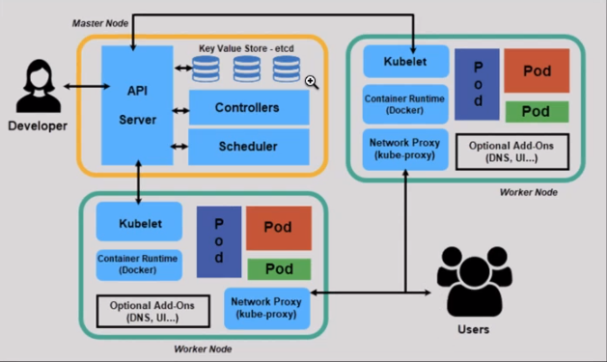

Slide 3
There are different types of componants in the Kubernetes architecture
1.API Server :-
it works like a gateway to external services
all the information coming to master should pass through API Server
2.Controller :-
It takes all the info from API Server and passes the information to kubelet
3.Scheduler :-
It watches the health of the PODs if any POD is failing to perform operations it will inform it to controller
4.Etcd :-
It will store key-value pairs and master and worker data
5. Kubelet :-
It is responsible for starting PODs on the worker node
6. Kubeproxy :-
It is responsible for internal communication
Using K8S we can operate different containarised applications in different environments
It has changed the architecture from Monolithic to Micro services architecture
K8S provides some important features like
High availability with almost no down time
Scale-up features according to requirements
Disaster recovery

Slide 4
PODS
Pods are the smallest and basic deployable objects in Kubernetes.
Usually we run one container per POD
We can run more than 1 container per POD but the resources of the POD will be shared among the containers.
Every POD has a different IP address
PODs are self-healing in nature. i.e, if any disaster appears it will restart automatically

Slide 5
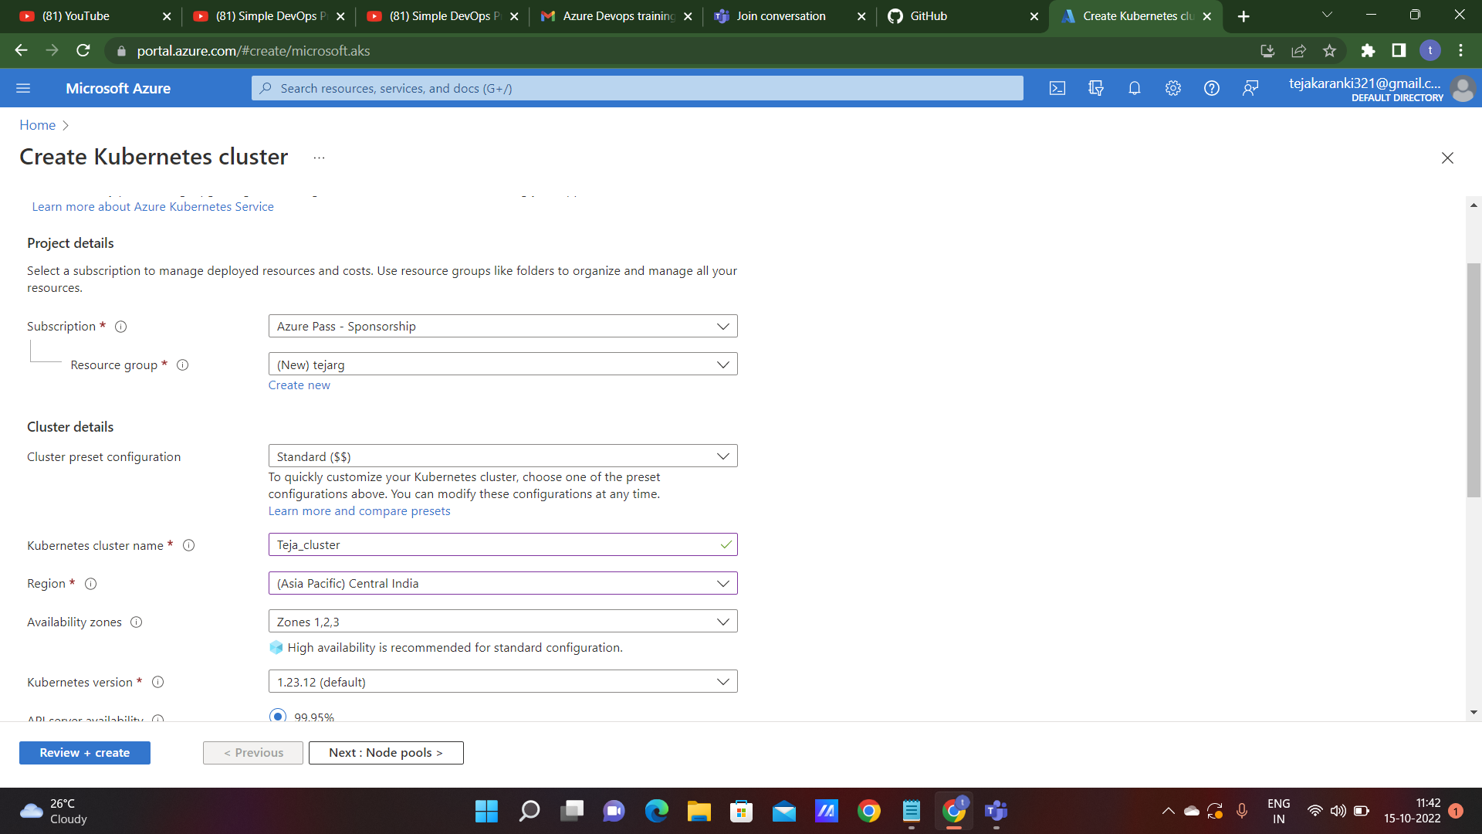
Creating AKS cluster

Slide 6
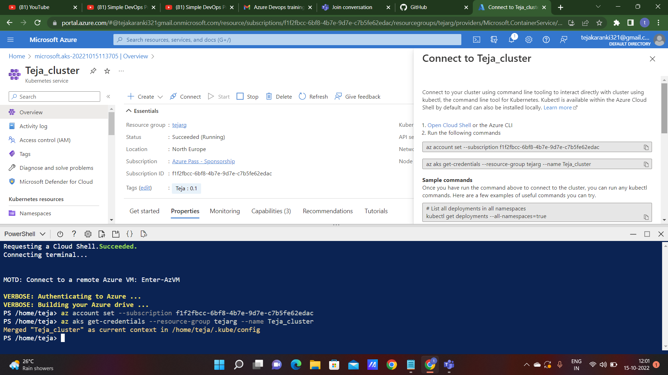
AKS cluster created

Slide 7
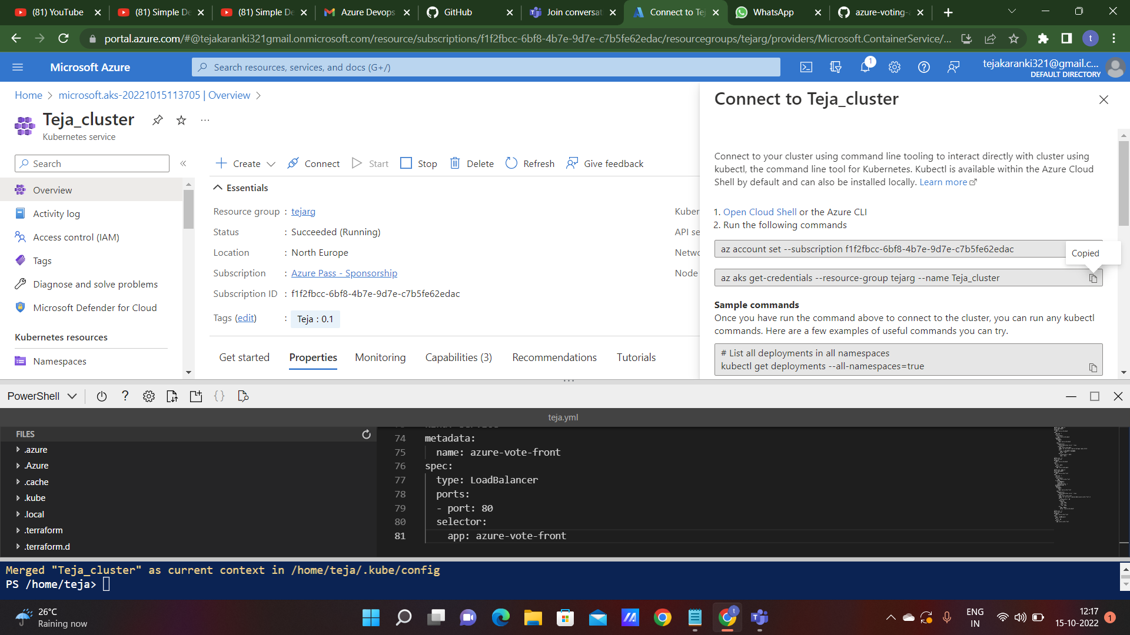
Connecting AKS cluster to P.T

Slide 8
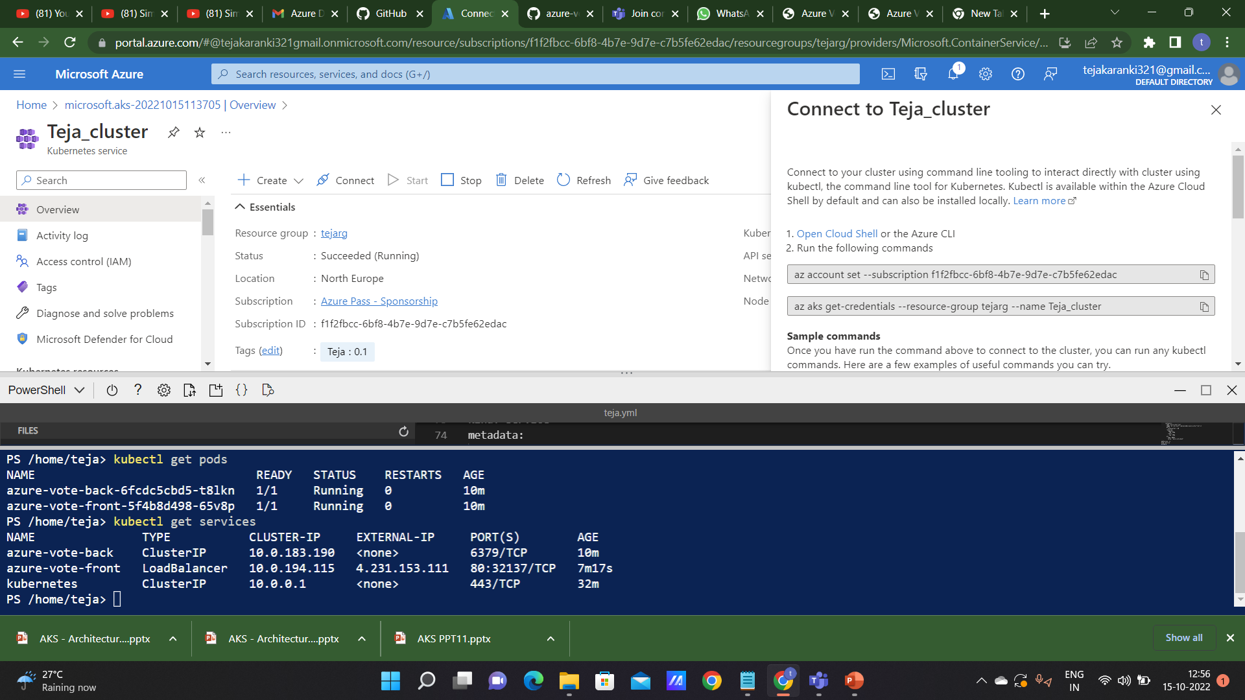
Run the command to run the yaml file

Slide 9
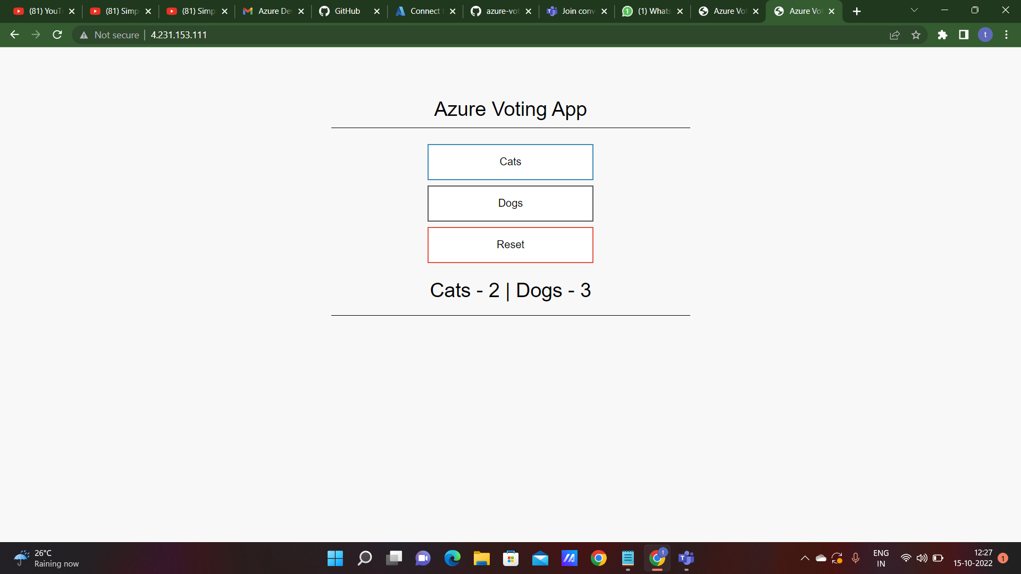
Copy the external IP address and paste it in the browser to get the output

Slide 10
Thank you

